Slide 1
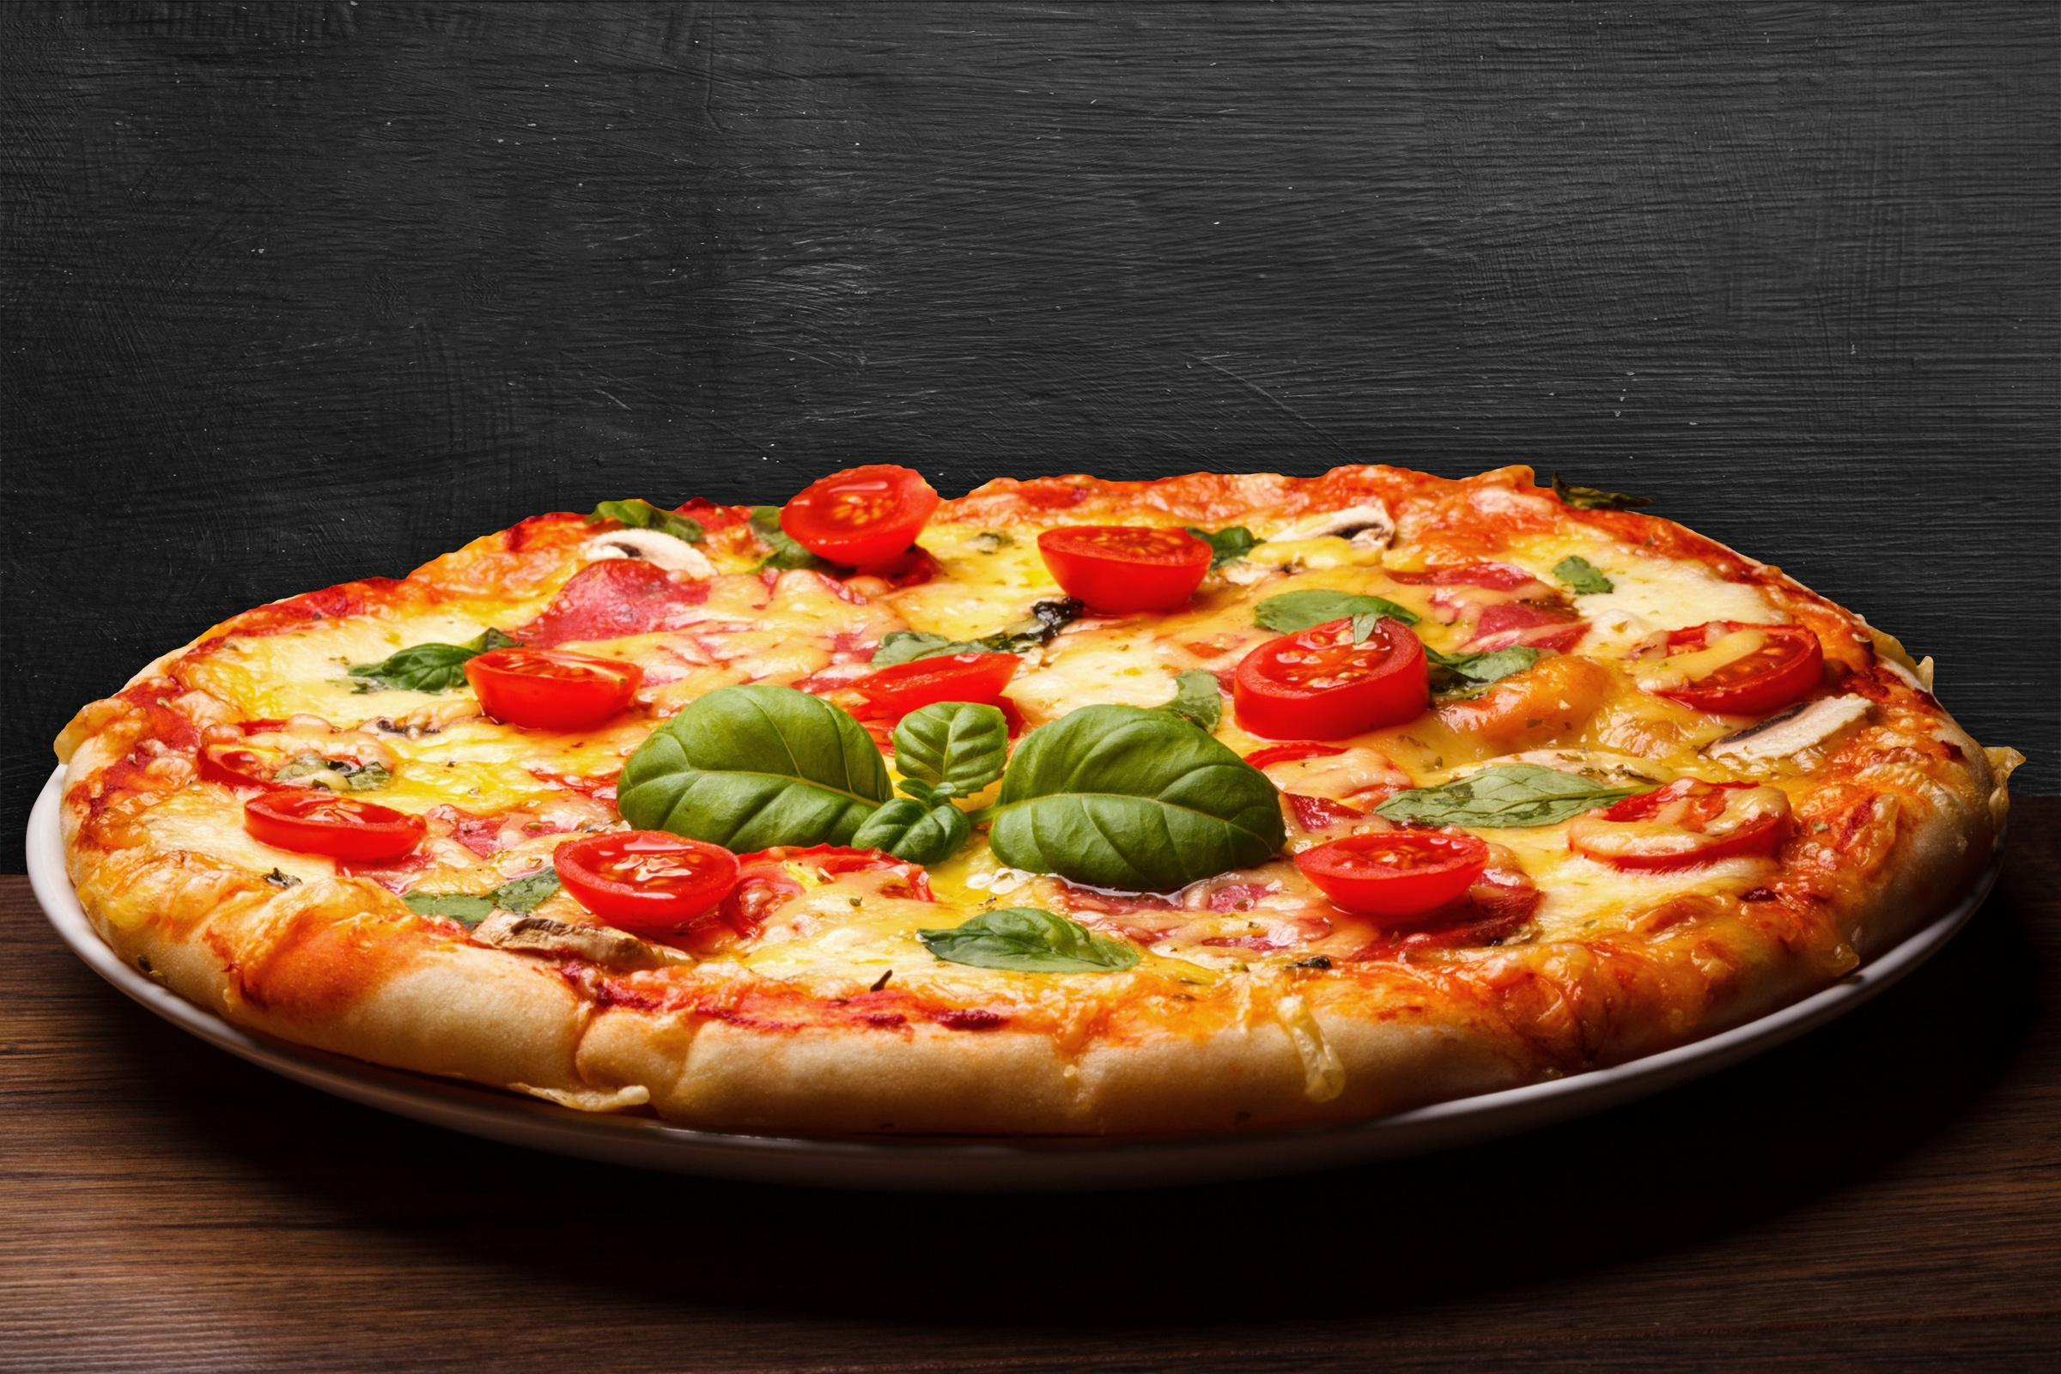

pizza hut
pizza HUT sql project

Slide 2


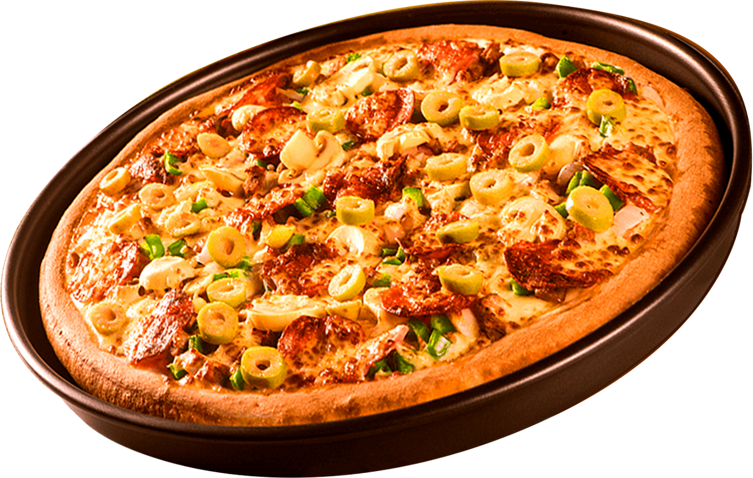

pizza HUT
welcome to
pizza HUT
Pizza Hut is a popular American restaurant chain and international franchise known for its delicious pizzas, pasta, sides, and desserts. Founded in 1958 by two brothers, Dan and Frank Carney, in Wichita, Kansas,
Pizza Hut has grown to become one of the largest pizza chains in the world.It's famous for a variety of crust options, including Pan Pizza, Stuffed Crust,and Thin ‘N Crispy, along with a wide selection of toppings. Pizza Hut operates dine-in restaurants, takeout, and delivery services across man countries, offering both local and global flavors.

Slide 3


PIZZA HUT
SCHEMAS USED IN PIZZA HUT ANALYSIS
Order Details
Orders
Pizza Types
Pizzas

Slide 4
pizza hut
BASIC QUERIES
Retrieve the total number of orders placed.
Calculate the total revenue generated from pizza sales.
Identify the highest-priced pizza.
Identify the most common pizza size ordered.
List the top 5 most ordered pizza types along with their quantities.

Slide 5

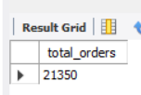
pizza hut
Retrieve the total number of orders placed

Slide 6
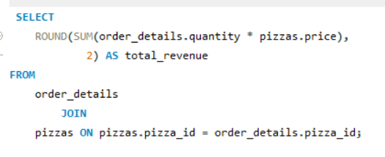
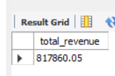
pizza hut
Calculate the total revenue generated from pizza sales.

Slide 7
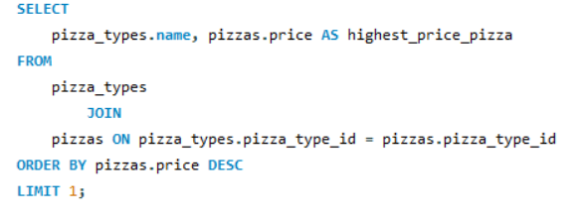
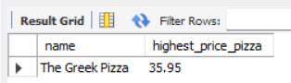
pizza hut
Identify the highest-priced pizza.

Slide 8
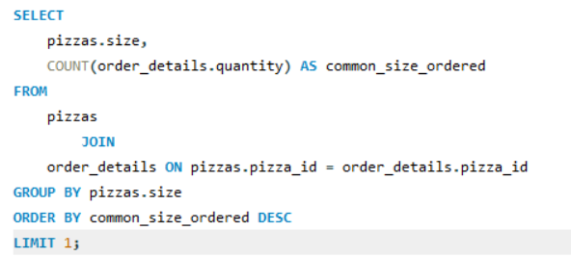
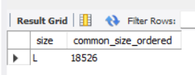
pizza hut
Identify the most common pizza size ordered.

Slide 9
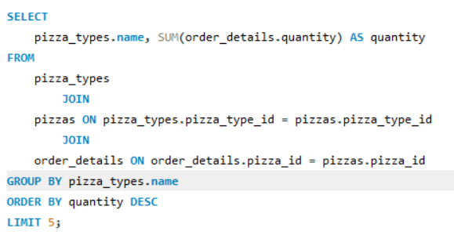
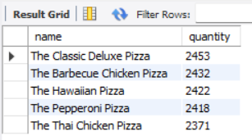
pizza hut
List the top 5 most ordered pizza types along with their quantities.

Slide 10
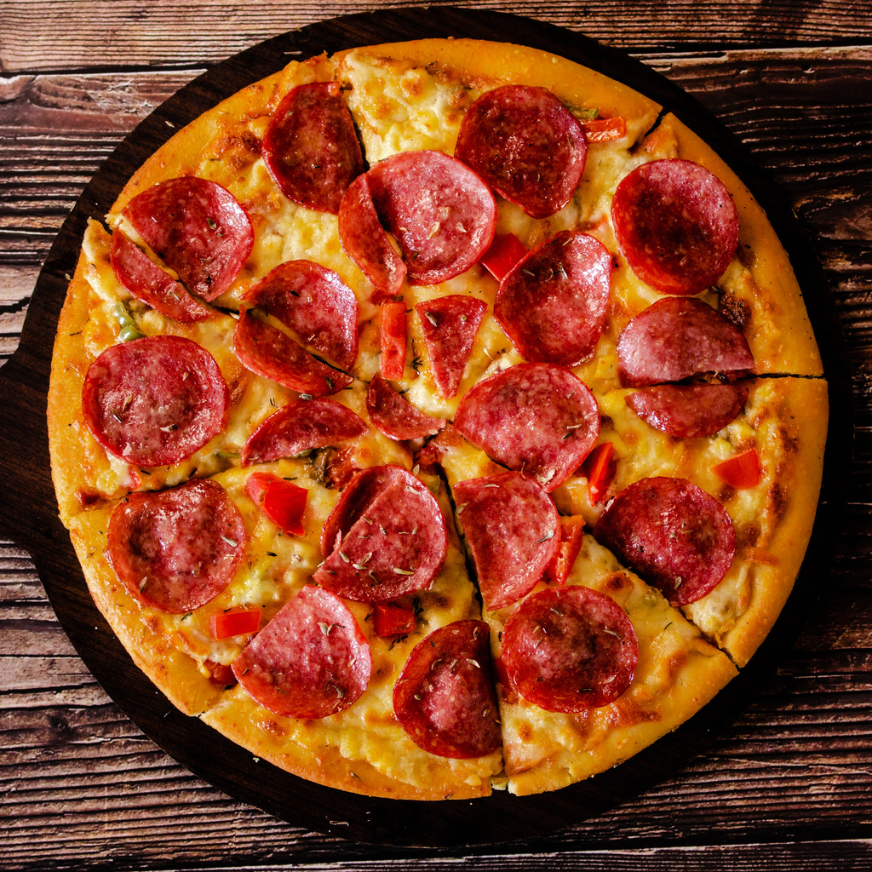



pizza hut
INTERMEDIATE QUERIES
Join the necessary tables to find the total quantity of each pizza category ordered.
Determine the distribution of orders by hour of the day.
Join relevant tables to find the category-wise distribution of pizzas.
Group the orders by date and calculate the average number of pizzas ordered per day.
5.Determine the top 3 most ordered pizza types based on revenue.
$6
$6
$6
$6

Slide 11
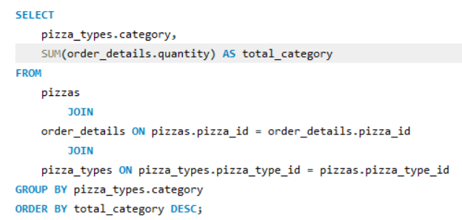
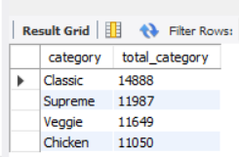
pizza hut
Join the necessary tables to find the total quantity of each pizza category ordered.

Slide 12
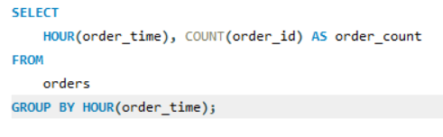
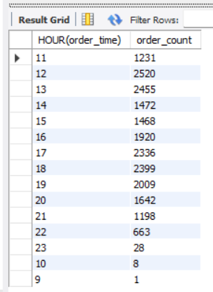
pizza hut
Determine the distribution of orders by hour of the day.

Slide 13
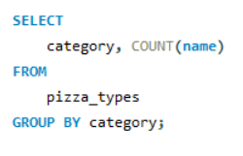
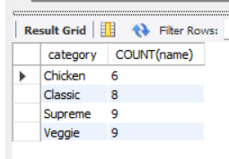
pizza hut
Join relevant tables to find the category-wise distribution of pizzas.

Slide 14
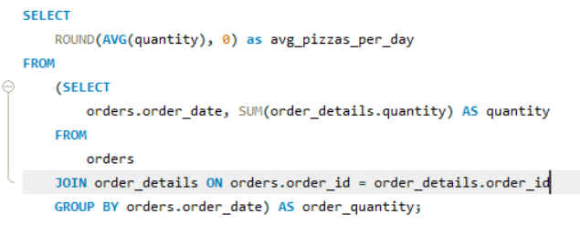
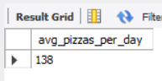
pizza hut
Group the orders by date and calculate the average number of pizzas ordered per day.

Slide 15
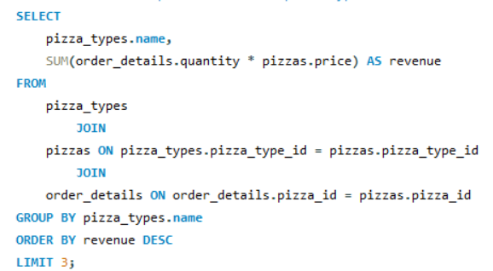
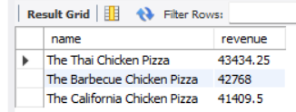
pizza hut
Determine the top 3 most ordered pizza types based on revenue.

Slide 16
pizza hut
ADVANCED QUERIES
Calculate the percentage contribution of each pizza type to total revenue.
Analyze the cumulative revenue generated over time.
Determine the top 3 most ordered pizza types based on revenue for each pizza category.
$6
$6
$6
$6

Slide 17
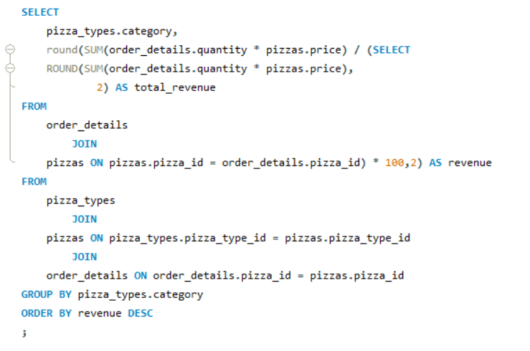
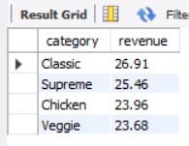
pizza hut
Determine the top 3 most ordered pizza types based on revenue.

Slide 18
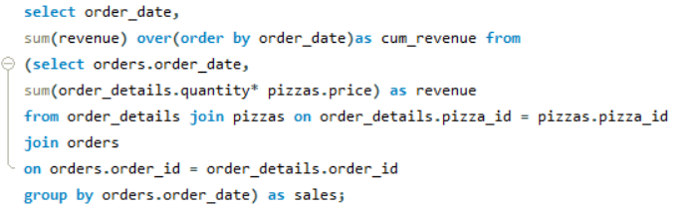
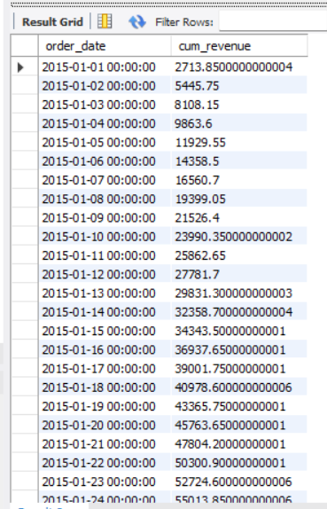
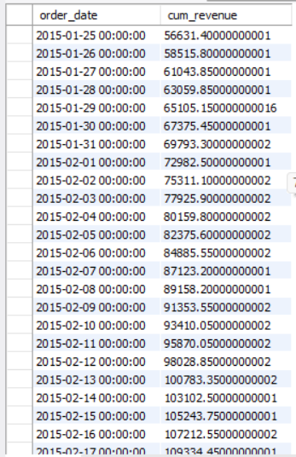
pizza hut
Analyze the cumulative revenue generated over time.

Slide 19
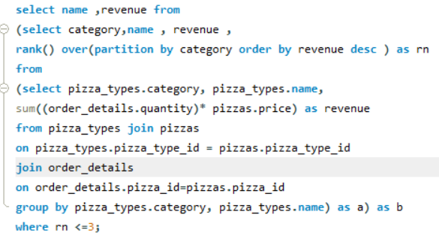
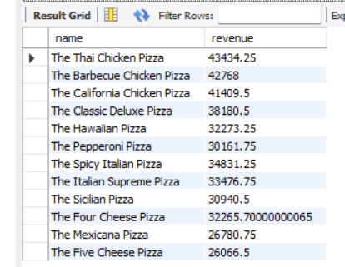
pizza hut
Determine the top 3 most ordered pizza types based on revenue for each pizza category.

Slide 20
PIZZA HUT
thank you!

